Slide 1
The Pod
An idea for the future of logistics...

Slide 2
Introduction
The Pod is an innovative concept that shall revolutionize modern logistics.
In essence, the Pod is a short (4.5m/15’) container/swap body hybrid that can be combined to form a full length intermodal loading unit (13.6m/45’).
Due to a high degree of flexibility, the Pod enhances the advantages of less than truckload (LTL) freight transport by simplifying load consolidation and reducing transhipment activities.
Lastly, the Pod can spawn a new generation of logistics service providers...

Slide 3
Introduction

Slide 4
Background
At present, semi-trailers are the largest, most common, and most efficient loading units for freight transport.
Nevertheless, semi-trailers require a substantial amount of freight to make them economically viable (i.e. full truckloads).
Where full truckloads (FTL) are impossible, less than truckload (LTL) freight transport is a cost-effective alternative.
However, modern LTL freight transport is a complex and costly operation...

Slide 5
The Problem
Since typical semi-trailers are used in LTL freight transport, transhipment is required at the beginning and end of each movement.
This transhipment not only increases operational costs and delivery times, it also exposes freight to unnecessary risks (e.g. damage and loss).
Furthermore, load consolidation is complex, as large infrastructure, skilled workforces, and sophisticated systems are required.
Lastly, industry coordination is lacking, so empty return trips are common.

Slide 6
The Solution
By reducing the size of the loading unit, load consolidation is simplified as the amount of freight required for economic viability is reduced.
In addition, by consolidating freight in smaller loading units, transhipment is also reduced as only the Pods are transferred in most cases.
With the inclusion of free-standing capability, the Pod improves utilization of trucks and drivers, so fewer are eventually required.
As an intermodal loading unit, the Pod can lower costs over long distances.

Slide 7
The Pod

Slide 8
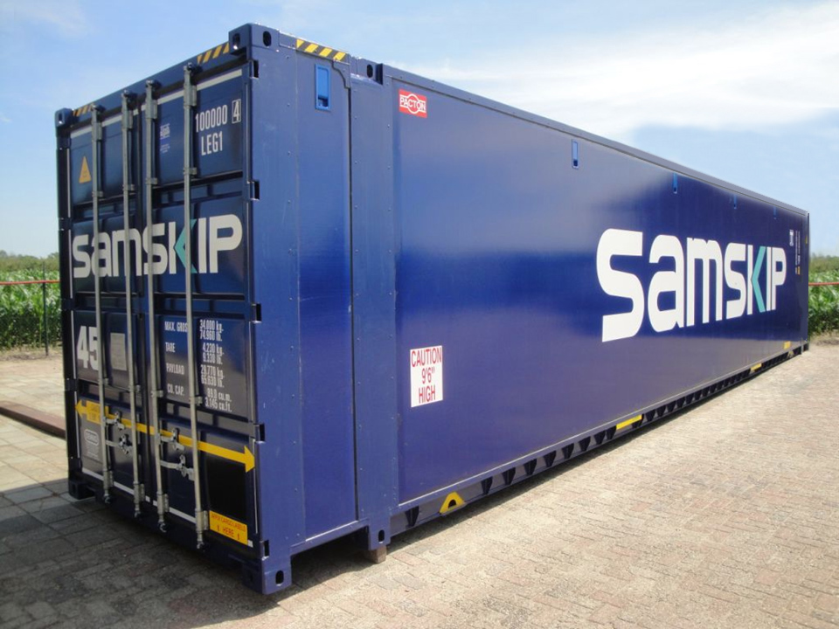
The Pod - Overview
The Pod is built with DOMEX steel and DSM panels, like the HighQ concept:

Slide 9
The Pod - Overview
The Pod is built with the following dimensions and technical specifications:
Capacity : 10 x Pallets (EUR) / 8 x Pallets (ISO)
Weight : 1,250 kg (Empty) / 11,000 kg (Gross)
Length : 4,500 mm (Overall) / 4,280 mm (Internal)
Height : 2,780 mm (Overall) / 2,440 mm (Internal)
Width : 2,500 mm (Overall) / 2,440 mm (Internal)
Coupling Heights : 1,220 mm (Rigid) / 1,100 mm (Artic)
Ground Heights : 1,390 mm (Floor) / 4,000 mm (Roof)

Slide 10
The Pod - Overview
By way of a base frame, three Pods can be combined to form a full length intermodal loading unit with specifications as follows:
Capacity : 30 x Pallets (EUR) / 24 x Pallets (ISO)
Weight : 5,000 kg (Empty) / 34,000 kg (Gross)
Length : 13,600 mm (Overall) / 13,380 mm (Internal)
Height : 2,780 mm (Overall) / 2,440 mm (Internal)
Width : 2,500 mm (Overall) / 2,440 mm (Internal)
Stacking : 5 x 34,000 kg @ 40’ Position

Slide 11
The Pod - Overview
The base frame fits on typical 45’ semi-trailers or 45’ railcars and loads three (3) Pods...

Slide 12
The Pod - Overview
Three (3) Pods loaded on a base frame effectively become a 45’ intermodal container, which can be transported via road, rail, and sea...

Slide 13
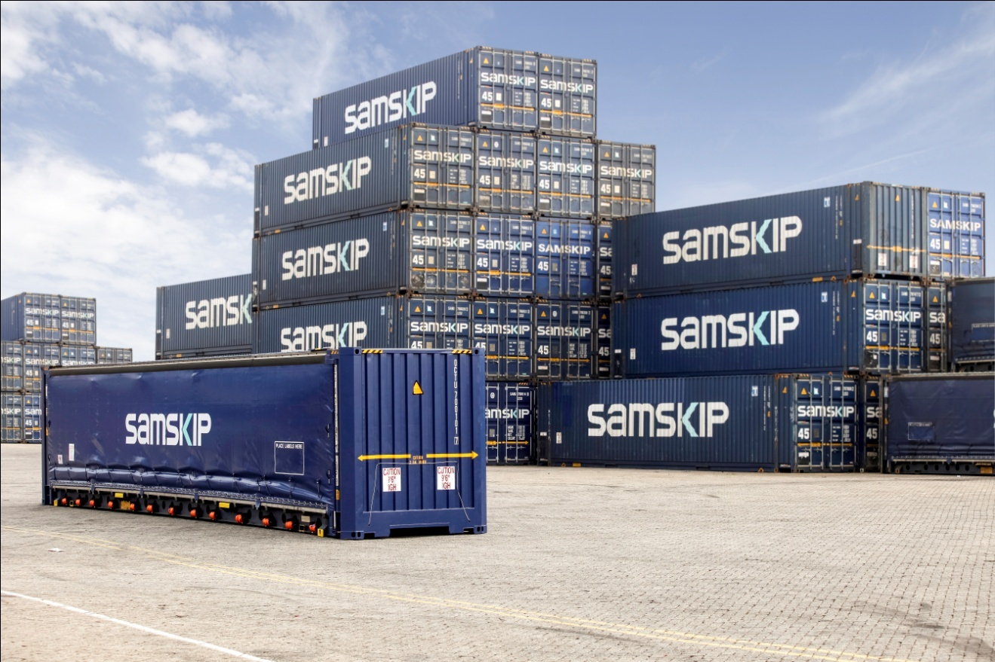
The Pod - Overview
Three (3) Pods on a base frame are stacked like 45’ intermodal containers:

Slide 14
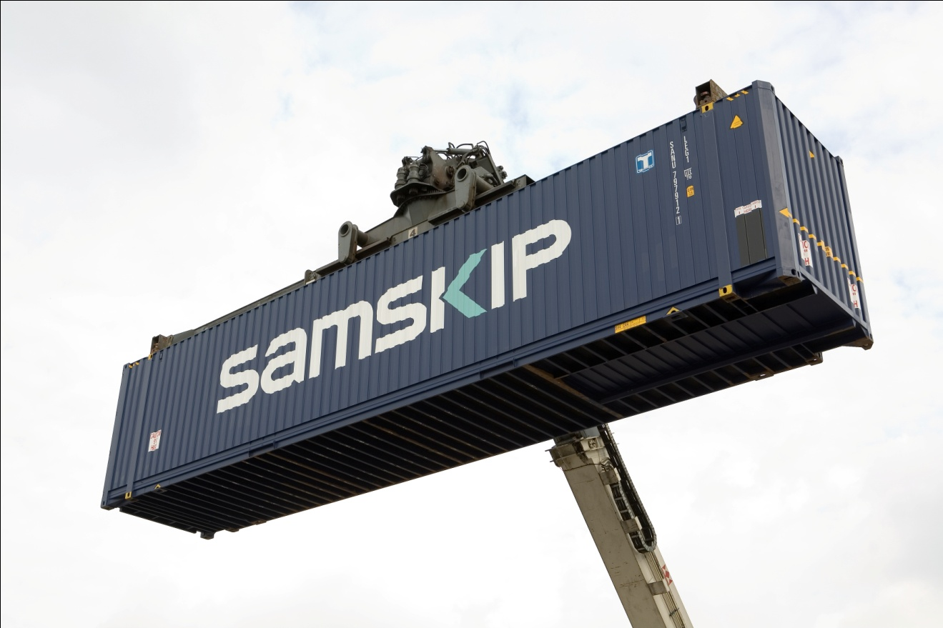
The Pod - Overview
Three (3) Pods on a base frame are top-lifted like 45’ intermodal containers:

Slide 15
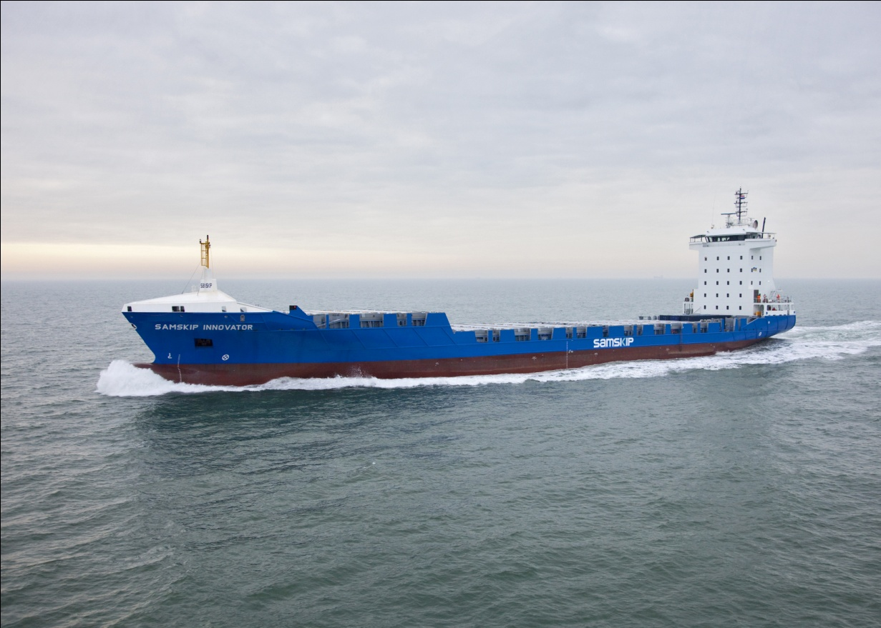
The Pod - Overview
Top-lifting and stacking capability permit transport via 45’ container ships:

Slide 16
The Pod - Overview
Three (3) Pods can be unloaded from a base frame and loaded with freight simultaneously, without a truck and driver present...

Slide 17
The Pod - Overview
Three (3) Pods can be combined internally to provide FTL freight transport as well as LTL...

Slide 18
The Pod - System
The Pod allows for a high degree of flexibility, which when used effectively, enhances the advantages of less than truckload (LTL) freight transport.
As with typical LTL freight transport operations, a pallet becomes the least common multiple for consolidating freight.
Each Pod is designed to load ten (10) EUR pallets or eight (8) ISO pallets, in two columns of five rows (EUR) or four rows (ISO) respectively.
In contrast, 33 EUR pallets or 26 ISO pallets are needed to fill semi-trailers.

Slide 19
The Pod - System
A single Pod is designed to be transported with light-duty or medium-duty rigid trucks (12-18,000 kg GVW).
Three Pods on a base frame are designed to be transported by heavy-duty articulated trucks (40-44,000 kg GCW).
Final deliveries and short-distance movements are made with rigid trucks, while medium-distance movements are made with articulated trucks.
Long-distance movements are made by articulated trucks, trains, or ships.

Slide 20
The Pod - System
Light-duty or medium-duty rigid trucks (12-18t GVW) transport single Pods.

Slide 21
The Pod - System
Heavy-duty articulated trucks (40-44t GCW) transport three Pods at a time.

Slide 22
The Pod - System
Trains and ships could transport numerous Pod combinations (3x) at a time.

Slide 23
The Pod - Operation
In and of itself, the Pod offers immense potential to improve the efficiency and capacity of LTL freight transport.
However, even greater potential can be realized if the Pod is part of a large single logistics network (LSLN).
In such a scenario, the movement of each Pod and Pod combination (3x) is coordinated through a central intelligence (e.g. UberPOD).
This new organization effectively becomes a key logistics service provider...

Slide 24
The Pod - Operation

Slide 25
The Pod - Operation
In essence, UberPOD is a means to connect shippers and carriers via Pods.
UberPOD has the capacity to coordinate the vast majority of palletized dry freight movements, as well as parcel and break-bulk freight.
Corporate and SME shippers register with UberPOD then book pallet slots within Pods, full Pods, or Pod combinations (i.e. FTL) as required.
Logistics companies register as carriers with UberPOD then purchase Pods, which are booked by shippers and even other carriers.

Slide 26
The Pod - Operation
By connecting shippers and carriers through a LSLN, UberPOD can increase the efficiency and capacity of the logistics industry as a whole.
Empty or partially-laden return trips are minimised, as freight movements are easily coordinated across different shippers and carriers.
Increasing freight demands are managed by increasing the total number of Pods in use, not necessarily increasing vehicles or warehouses.
Existing assets and journeys are optimized, allowing a sustainable future...

Slide 27
The Pod - Advantages
The Pod allows final deliveries and short-distance movements with smaller electric trucks, which reduces congestion and pollution in cities.
For shippers, the Pod provides lower shipping and operating costs, as well as a simple and reliable freight transport solution.
For logistics companies, the Pod improves fleet flexibility, truck and driver utilization, load consolidation, and fewer transhipment activities.
With the Pod, consumers can experience lower costs of goods over time...

Slide 28
The Pod - Disadvantages
Initially, the Pod requires considerable investments to be made by logistics companies in Pods, base frames, and electric trucks (12-18t GVW).
Three Pods in combination are heavier (+1,000 kg) and have a lower pallet capacity (-3 EUR / -2 ISO) than a typical 45’ intermodal container.
More effort is required to load and unload three Pods in combination than a typical 45’ intermodal container.
The internal height of a Pod is shorter (-110 mm) than typical swap bodies.

Slide 29
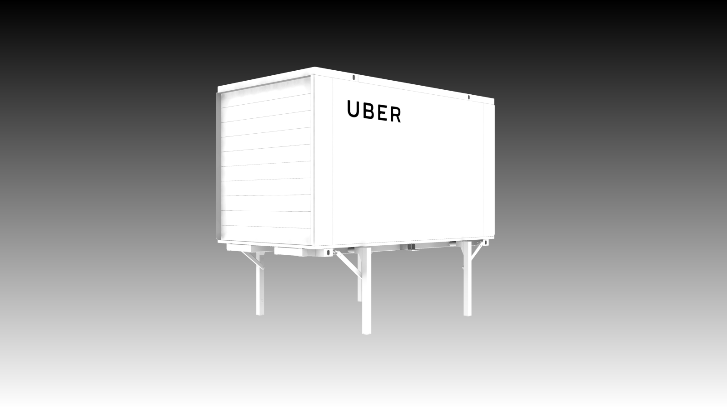
Many thanks for your attention!

