Slide 1
The FCC
A frameless container chassis for East Africa and other developing markets...

Slide 2
Background
ISO containers operate in demanding maritime conditions and are built to be extremely robust as well as self-supporting.
Standard ISO containers are designed to accommodate gross weights of up to 34,000kg and stacking weights in excess of 200,000kg.
While ISO containers are designed to be self-supporting, typical container chassis (i.e. skeletals) are built with heavy frames to support the container loads as well as absorb the forces from the fifth-wheel and bogie.
By eliminating the heavy frames and transferring loads and forces through ISO corner fittings, the weight and cost of typical container chassis can be reduced considerably!

Slide 3
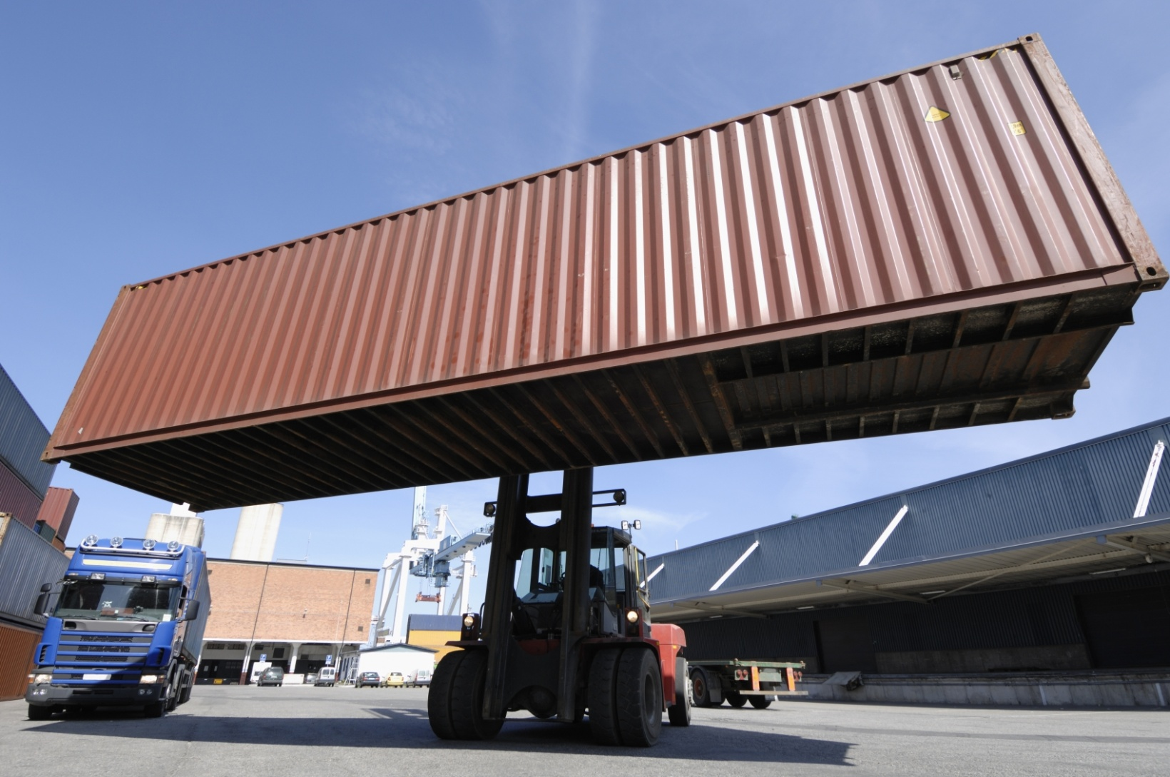
40’ ISO Container (lifted)

Slide 4
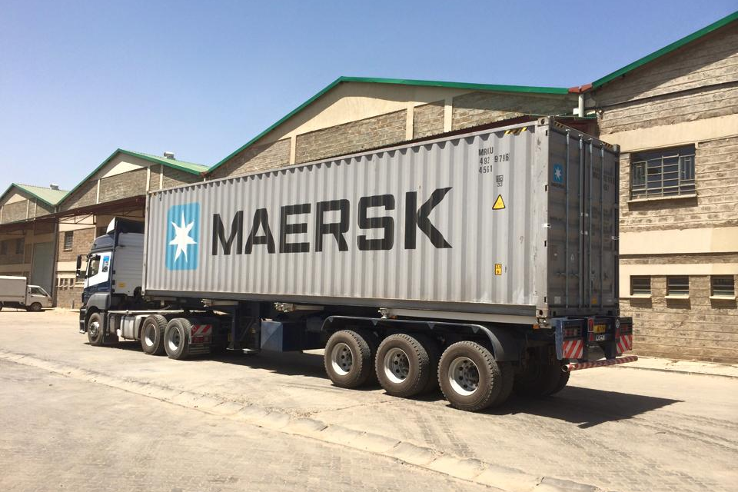
40’ ISO Container (loaded)

Slide 5
Introduction
By way of a clever yet simple approach, the FCC is devoid of a heavy frame and allows transfer of loads and forces through ISO corner fittings.
Furthermore, the novel design of the FCC improves manoeuvrability at low speeds, stability at high speeds, and overall tyre life.
Unlike typical container chassis, the FCC would incorporate modern trailer technologies, for instance: electro-pneumatic braking systems, disk brakes, pneumatic suspension, and single-mounted wheels.
Compared to typical container chassis, which weigh between 6,000kg and 7,000kg and cost between KES 2,350,000 to KES 2,850,000, the FCC would weigh approximately 3,500kg and cost around KES 2,500,000.

Slide 6
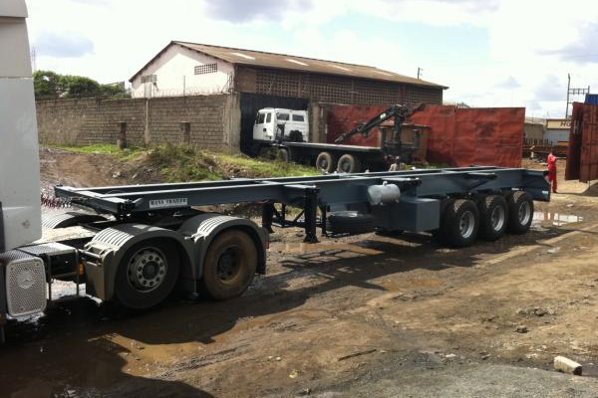
Typical Container Chassis

Slide 7
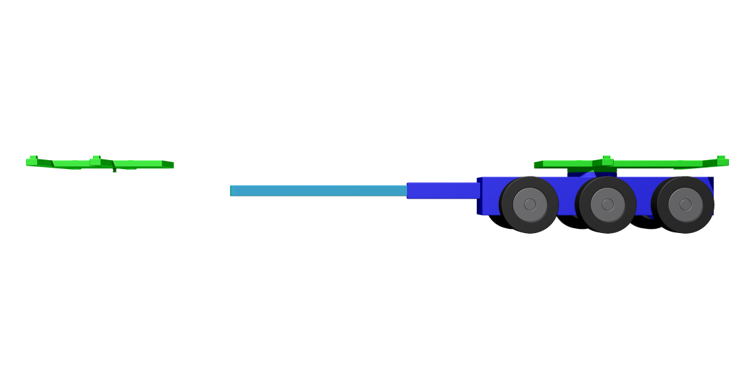
The FCC (concept)

Slide 8
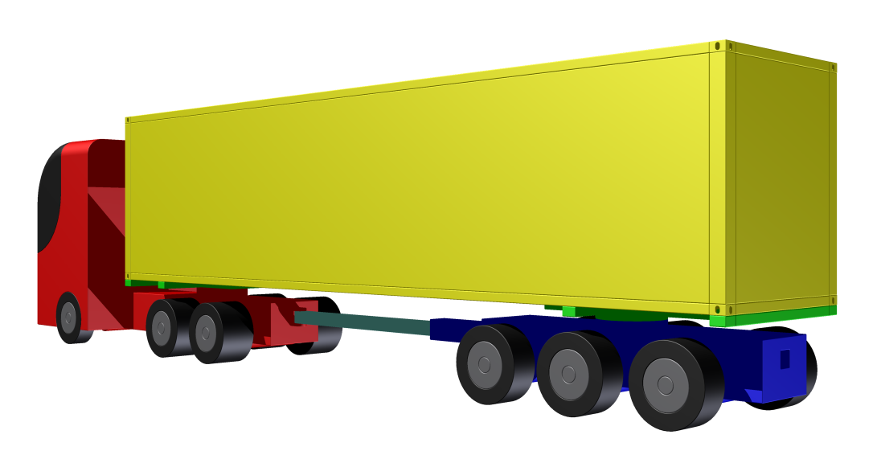
The FCC (concept)

Slide 9
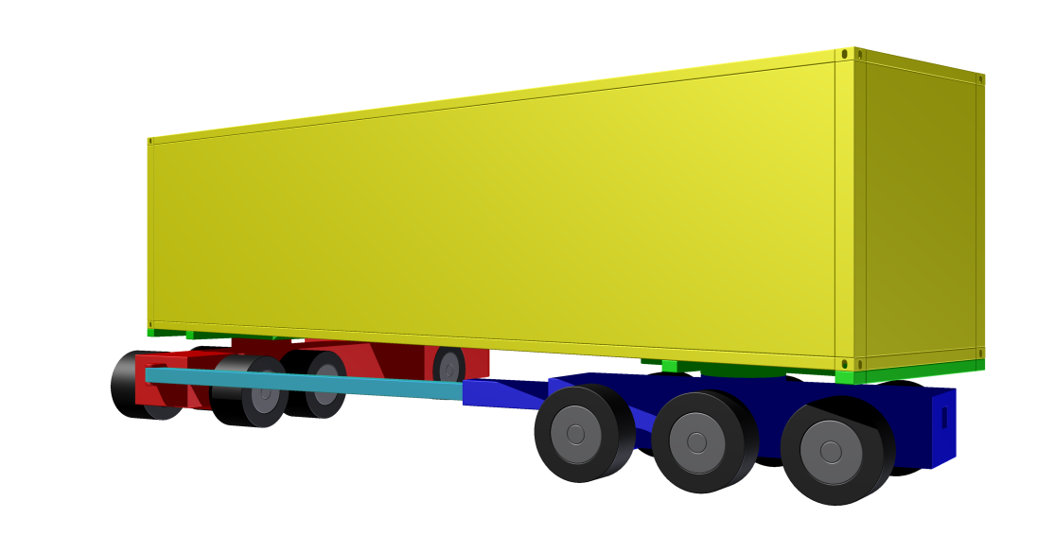
The FCC (concept)

Slide 10
Components
The FCC consists of four primary modules:
  Fifth-Wheel Platform: it supports the front end of an ISO container via its corner fittings and couples to the fifth-wheel on the tractor.
  Turntable Platform: it supports the rear end of an ISO container via its corner fittings and is fixed to the turntable on the ‘Trailing Bogie’.
  Trailing Bogie: it supports the ‘Turntable Platform’ and features three axles that are connected to the tractor via the ‘Drawbar Link’.
  Drawbar Link: it connects the ‘Trailing Bogie’ to the tractor via the tow coupling on the tractor.

Slide 11
Components
Fifth-Wheel Platform
Turntable Platform
Drawbar Link
Trailing Bogie

Slide 12
Compatibility
The FCC is compatible with typical three-axle tractors with the following features and modifications:
  Tow Coupling: fitted to the rearmost cross member.
  Trailer Connections: moved to the rearmost cross member.
The FCC is compatible with the following ISO containers and gross weights:
  1 x 20’ @ 34,000kg
  1 x 30’ @ 34,000kg
  1 x 40’ @ 34,000kg

Slide 13
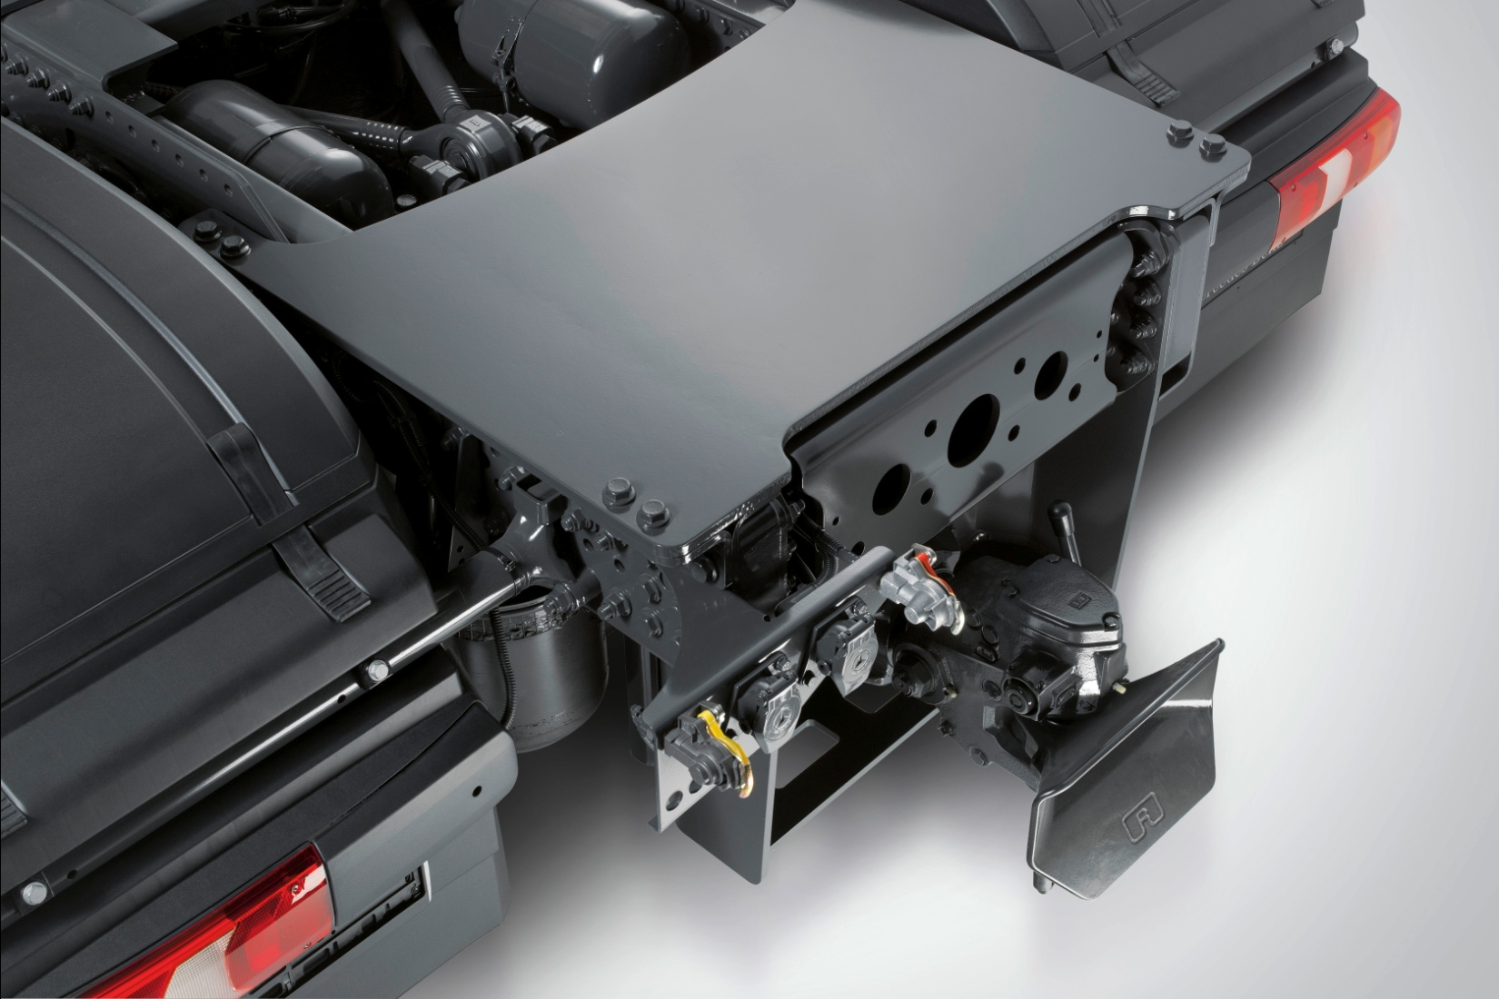
Compatibility – Tractor
Tow Coupling
Trailer Connections

Slide 14
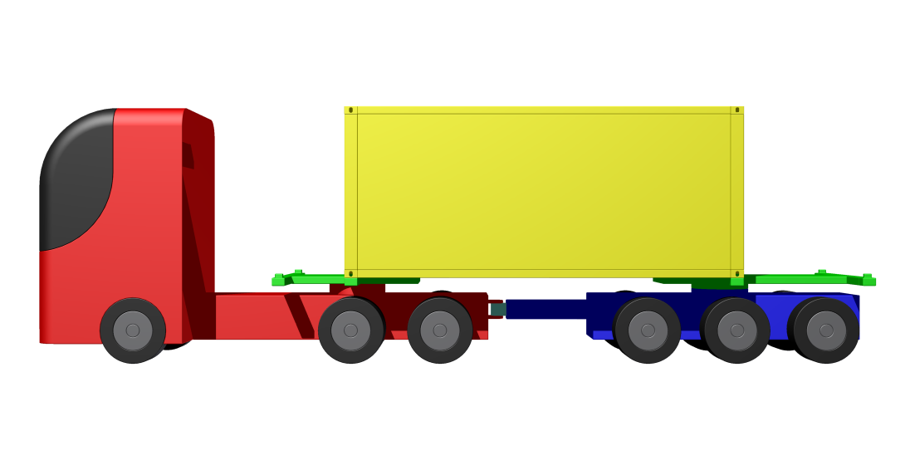
Compatibility – 1 x 20’

Slide 15
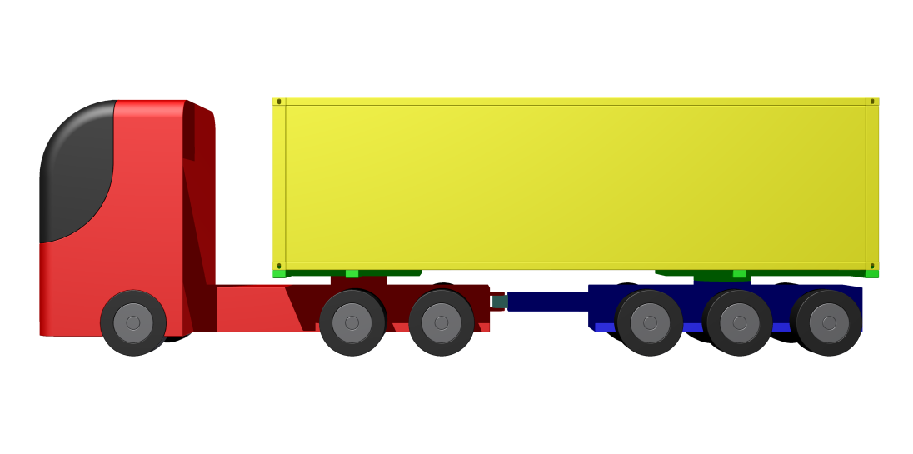
Compatibility – 1 x 30’

Slide 16
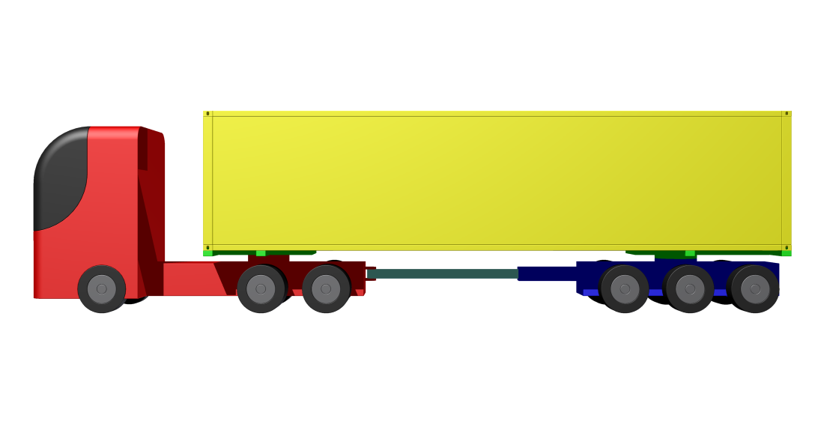
Compatibility – 1 x 40’

Slide 17
Target Weights
The FCC aims to weigh approximately 3,500kg, which is between 40-50% less than typical container chassis.
The target weights for the four primary modules are as follows:
  Fifth-Wheel Platform = 0,200 kg
  Turntable Platform = 0,250 kg
  Trailing Bogie = 2,750 kg
  Drawbar Link = 0,300 kg

Slide 18
Target Costs
The FCC aims to cost around KES 2,500,000, which is 6.5% higher than the cheapest typical container chassis and 12% lower than the most expensive typical container chassis.
Due to the production and material limitations in East Africa, the FCC may be manufactured in Europe and delivered to East Africa as CKD kits, which will reduce shipping costs and import duty.
All ancillary components shall be sourced from reputable European OEMs and delivered together with the manufactured parts.
The FCC shall be assembled in Kenya for sale across East Africa, as well as for export to other developing markets across the world.

Slide 19
Target Costs
The target final costs per unit are as follows:
  Manufacturing & Components = EUR 13,500 / KES 1,485,000
  Loading, Shipping, & Clearing = EUR 01,650 / KES 0,181,500
  Import Taxes, Fees, & Levies = EUR 03,000 / KES 0,311,000
  Assembly & Homologation = EUR 01,350 / KES 0,145,000
  Final Costs Per Unit = EUR 19,500 / KES 2,122,500
The target gross profit per unit is as follows:
  Unit Pricing (Excluding 16% VAT) = EUR 20,500 / KES 2,155,000
  Unit Costs (Excluding VAT Paid) = EUR 17,650 / KES 1,855,000
  Gross Profit Per Unit = EUR 02,850 / KES 300,000

Slide 20
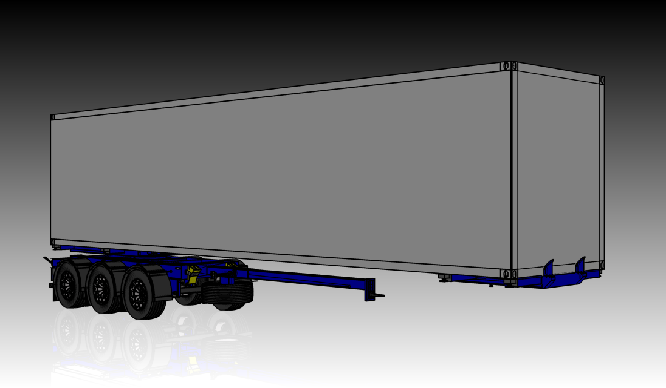
Thank You!

