Slide 1
The Box
An idea for the future of logistics...

Slide 2
Introduction
The Box is a modular and reusable packaging concept that is optimized for the Europallet standard.
In essence, the Box aims to increase efficiency of handling, productivity of loading, and flexibility of consolidation.
The Box is comprised of interconnecting panels that are snapped together to form packing units of various dimensions.
Upon delivery, the Box can be disassembled and reassembled as required.

Slide 3
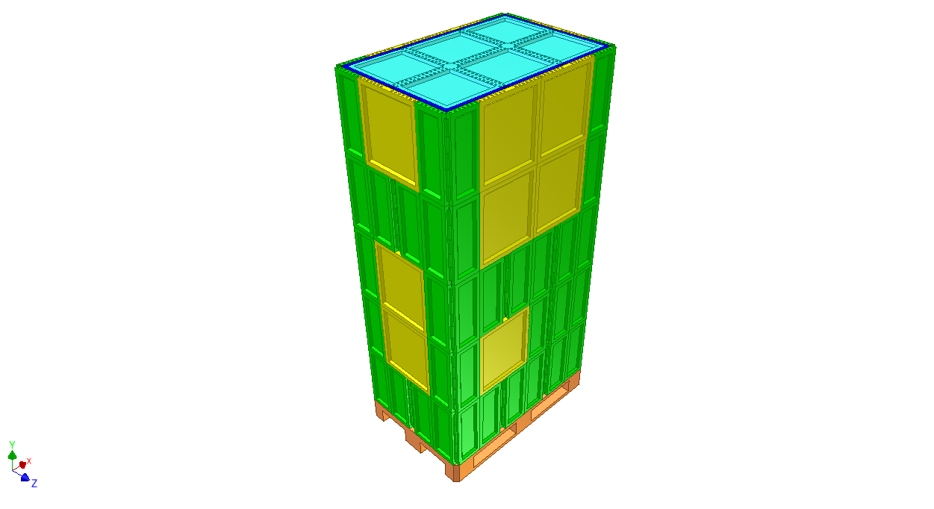
The Box

Slide 4
The Box
The Box consists of five primary modules:
Europallet
Base Modules
Corner Module
Side Module
Top Modules

Slide 5
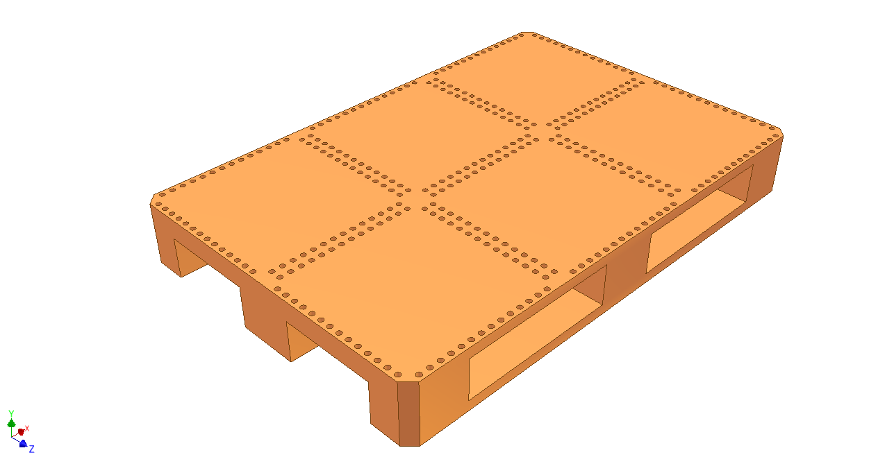
1) Europallet
The Box is designed to fit on a special version of Europallet, which features connecting points and RFID tags.
Dimensions
Length: 1,200 mm
Width: 800 mm
Height: 150 mm

Slide 6
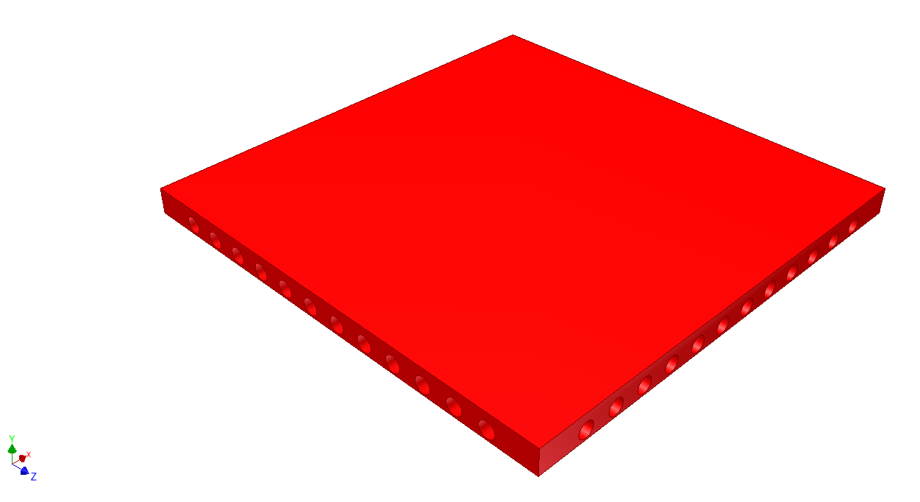
2) Base Modules
The Base Modules support the Corner and Side Modules. They are single body parts available in five sizes.
Dimensions (L x W)
350 mm x 350 mm
350 mm x 750 mm
350 mm x 1,150 mm
750 mm x 750 mm
750 mm x 1,150 mm

Slide 7
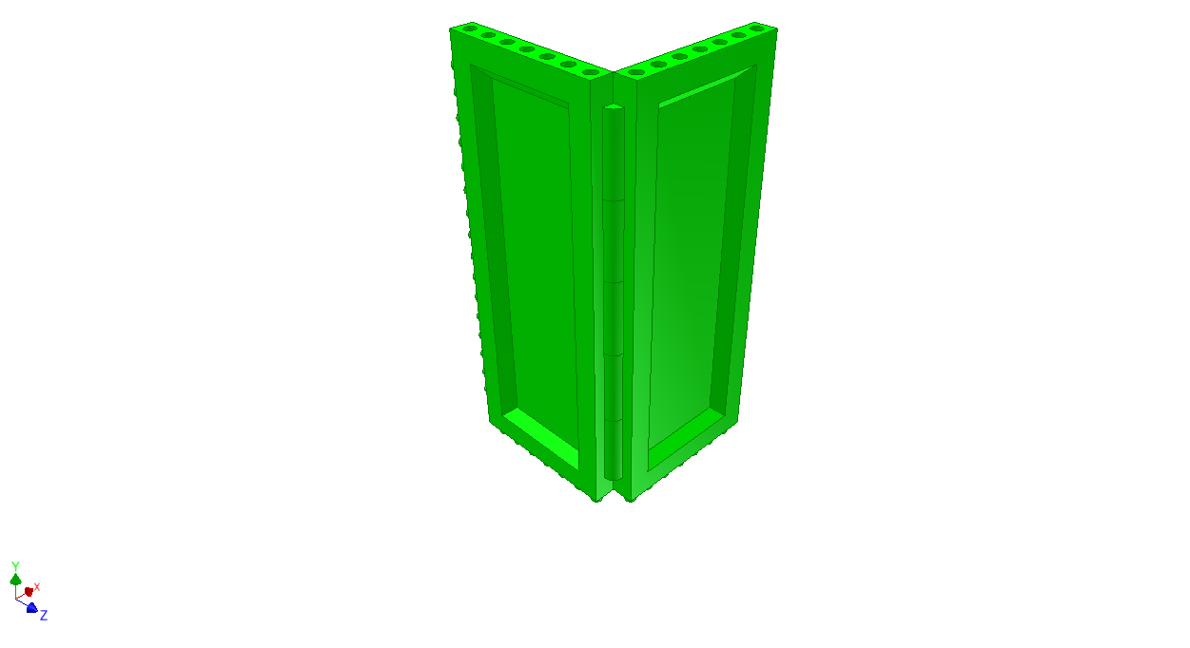
3) Corner Module
The Corner Module is snapped to a Base Module and the adjacent Corner or Side Modules.
Dimensions
Length: 200 mm
Width: 200 mm
Height: 450 mm

Slide 8
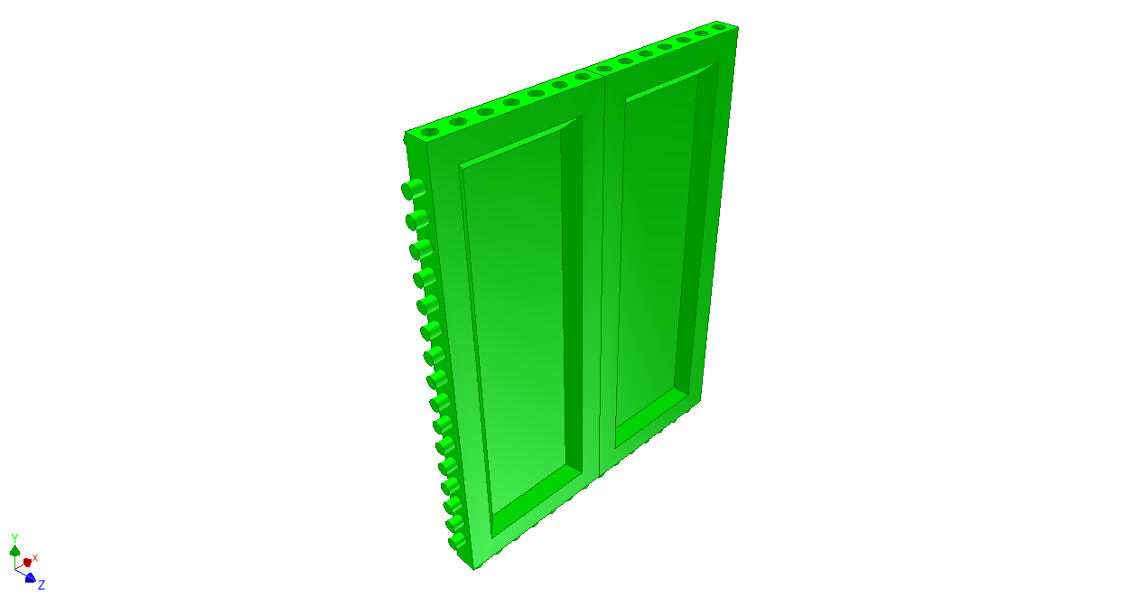
3) Corner Module
The Corner Module is hinged in the middle to enable it to be folded flat for minimal space usage when disassembled.
Dimensions
Length: 350 mm
Width: 25 mm
Height: 450 mm

Slide 9
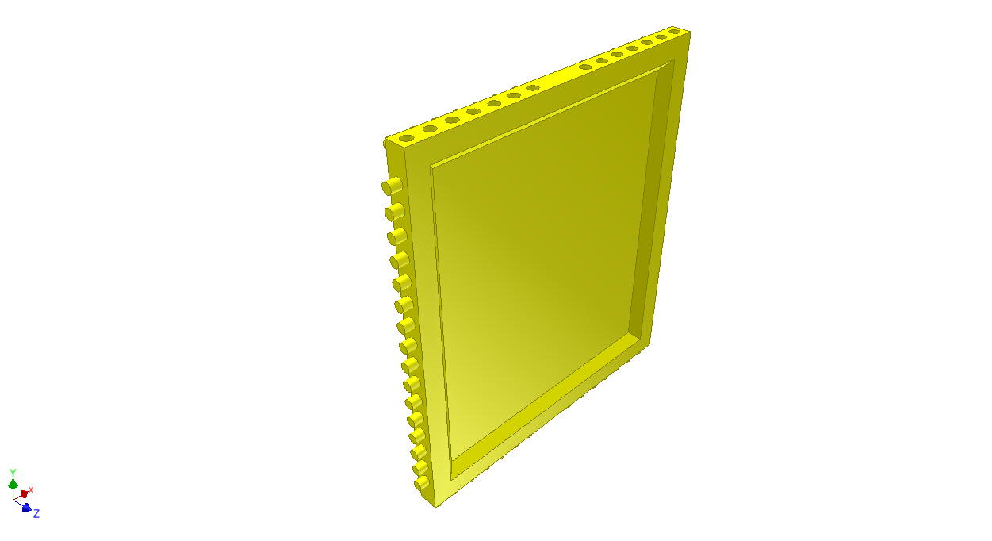
4) Side Module
The Side Module is used to fill gaps between Corner Modules when larger Box sizes are assembled.
Dimensions
Length: 400 mm
Width: 25 mm
Height: 450 mm

Slide 10
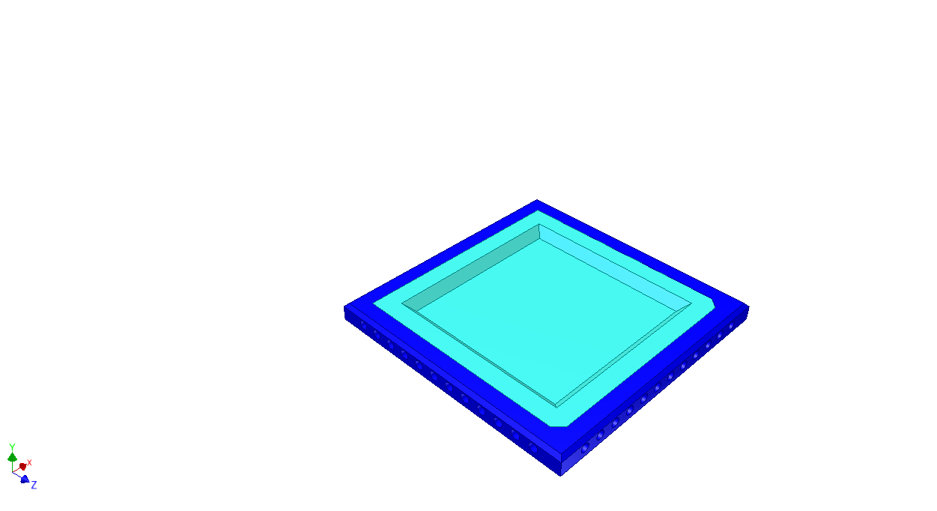
5) Top Module
The Top Modules are supported by the Corner and Side Modules. They are multibody parts available in five sizes.
Dimensions (L x W)
350 mm x 350 mm
350 mm x 750 mm
350 mm x 1,150 mm
750 mm x 750 mm
750 mm x 1,150 mm

Slide 11
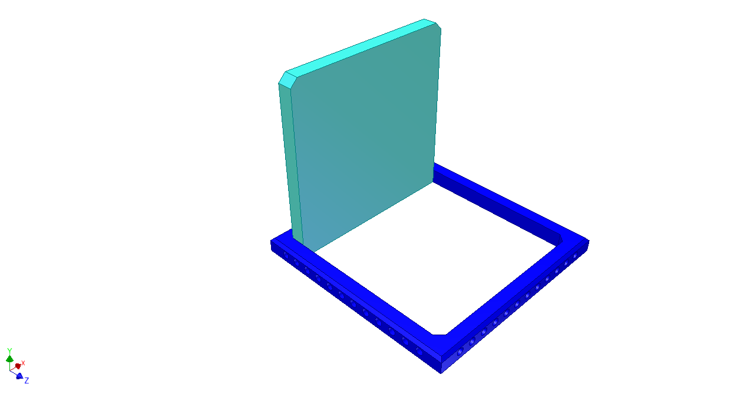
5) Top Module
The Top Modules feature an opening hatch, which allows the goods to be removed without disassembling the Box.
Dimensions (L x W)
350 mm x 350 mm
350 mm x 750 mm
350 mm x 1,150 mm
750 mm x 750 mm
750 mm x 1,150 mm

Slide 12
Variations
The Box can be assembled into five primary variations:
400 mm x 400 mm x 450 mm
400 mm x 800 mm x 450 mm
400 mm x 1,200 mm x 450 mm
800 mm x 800 mm x 450 mm
800 mm x 1,200 mm x 450 mm

Slide 13
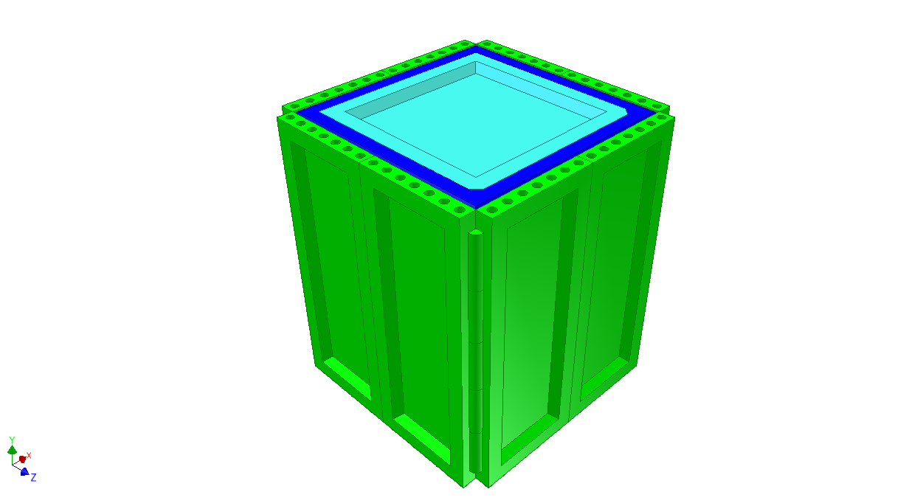
1) 400 mm x 400 mm x 450 mm

Slide 14
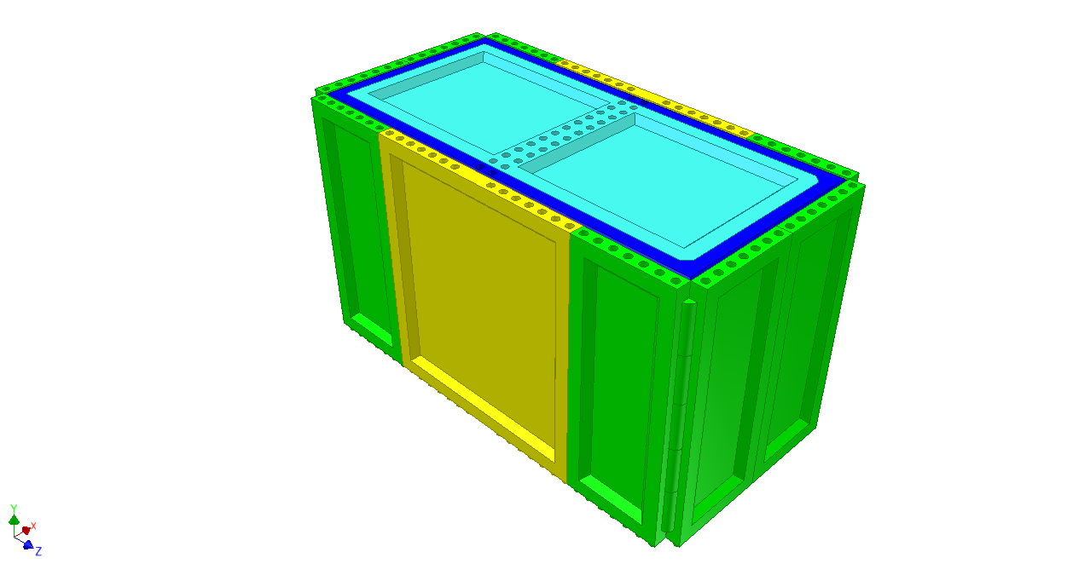
2) 400 mm x 800 mm x 450 mm

Slide 15
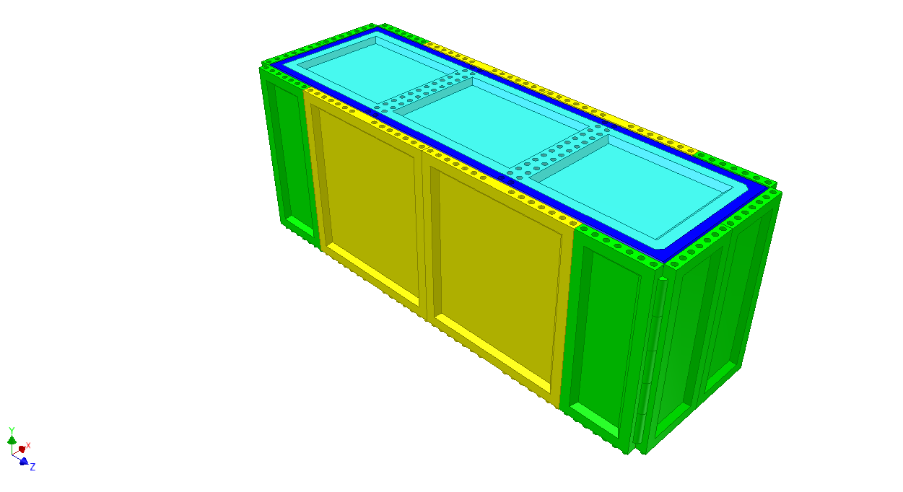
3) 400 mm x 1,200 mm x 450 mm

Slide 16
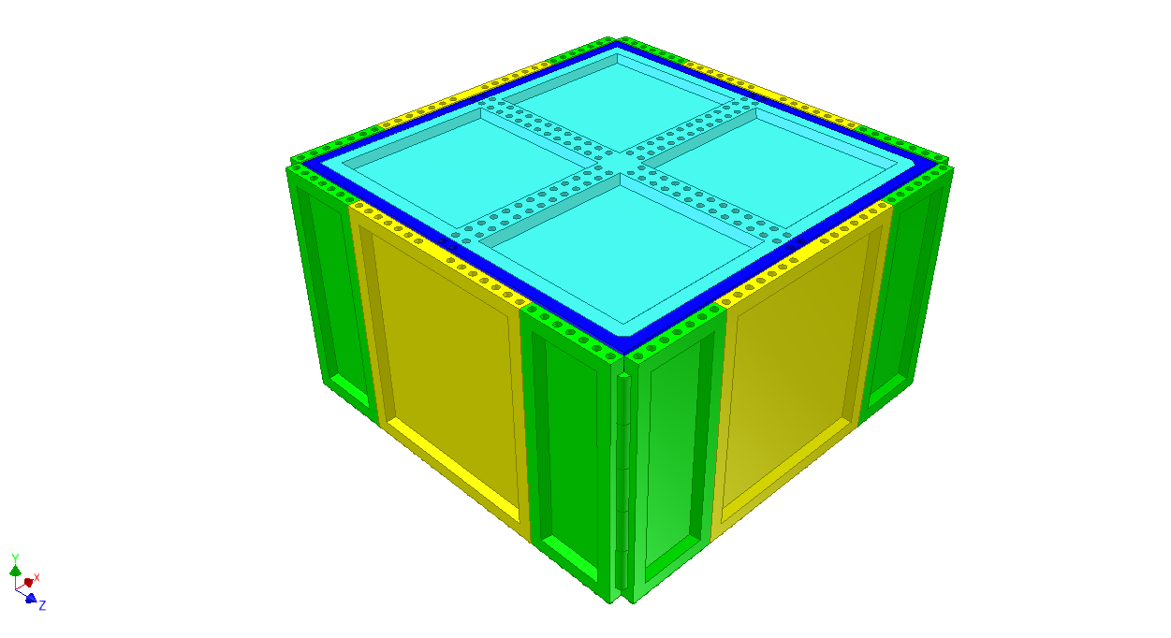
4) 800 mm x 800 mm x 450 mm

Slide 17
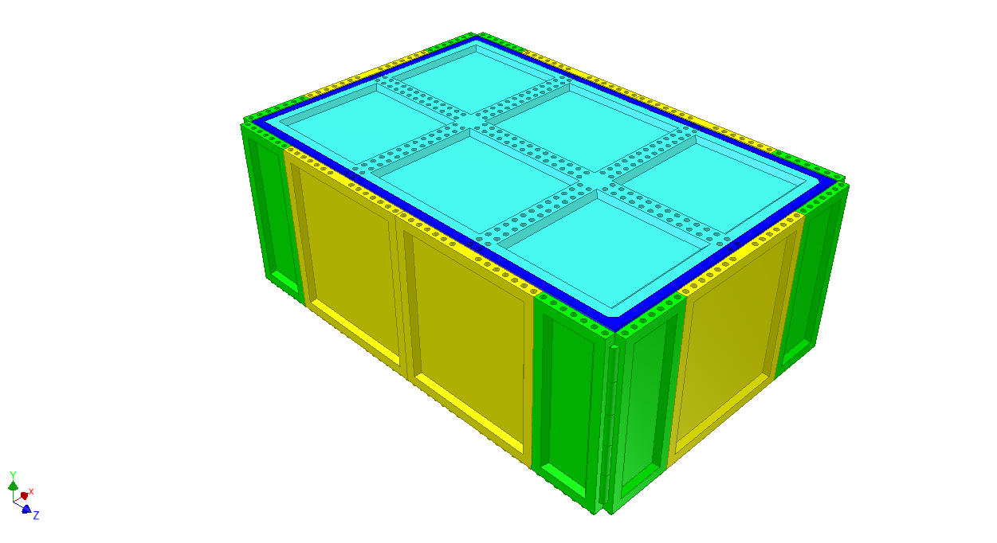
5) 800 mm x 1,200 mm x 450 mm

Slide 18
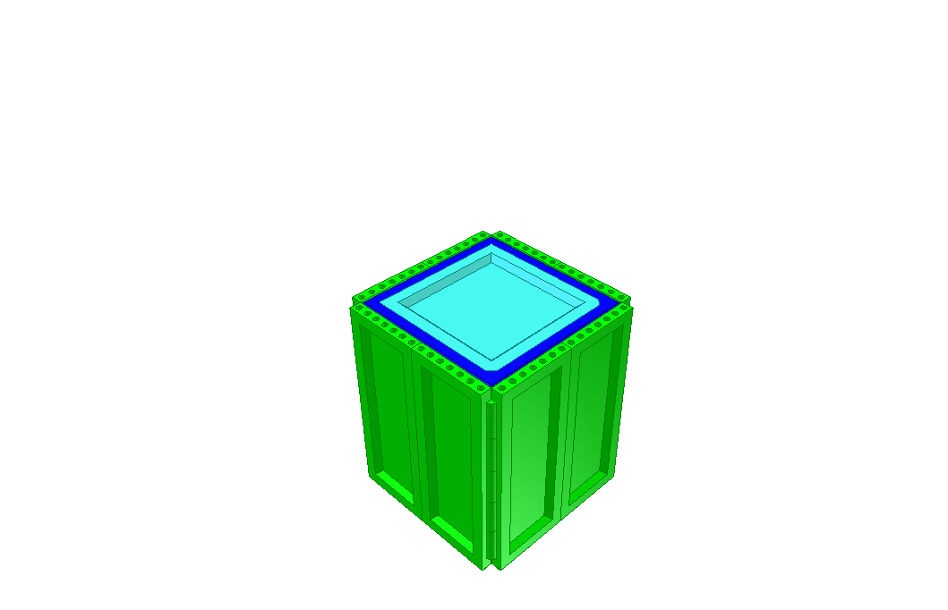
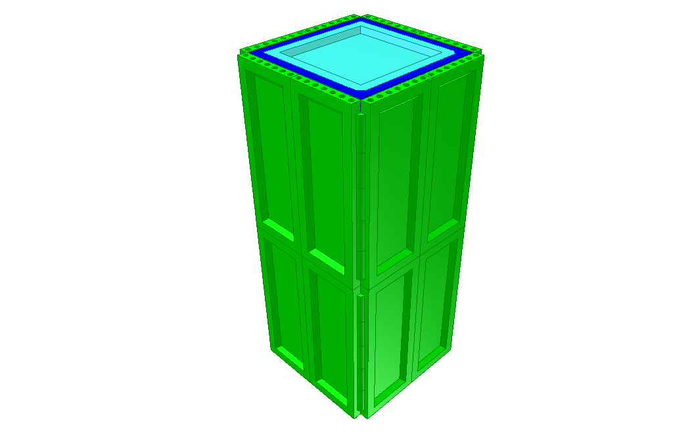
Variations
Furthermore, the height of each Box variation can be increased in 450 mm increments by adding Corner and Side Modules.

Slide 19
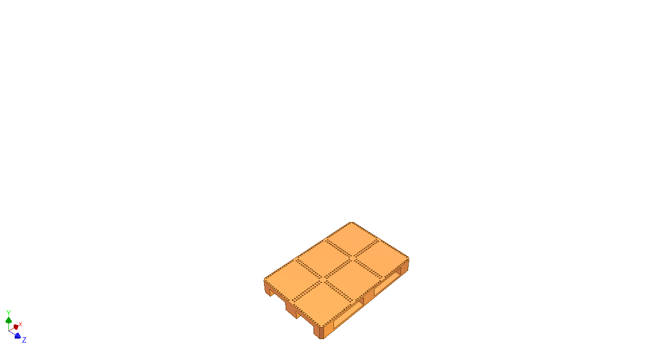
Consolidating various Box sizes on a Europallet...

Slide 20
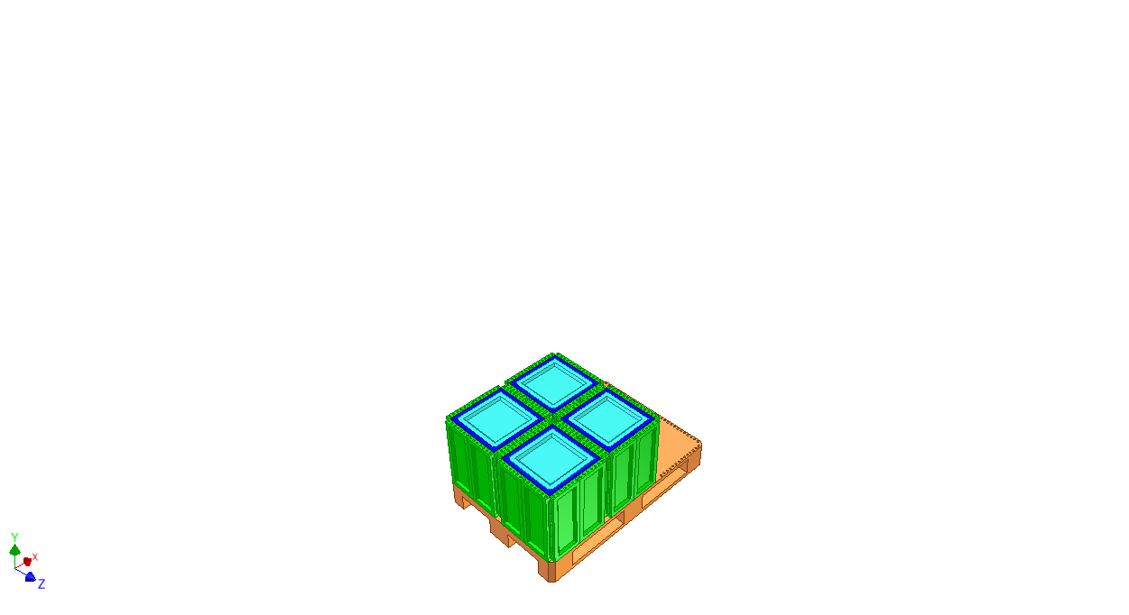
Consolidating various Box sizes on a Europallet...

Slide 21
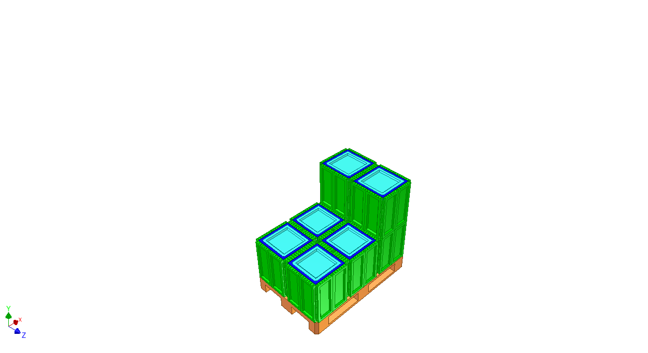
Consolidating various Box sizes on a Europallet...

Slide 22
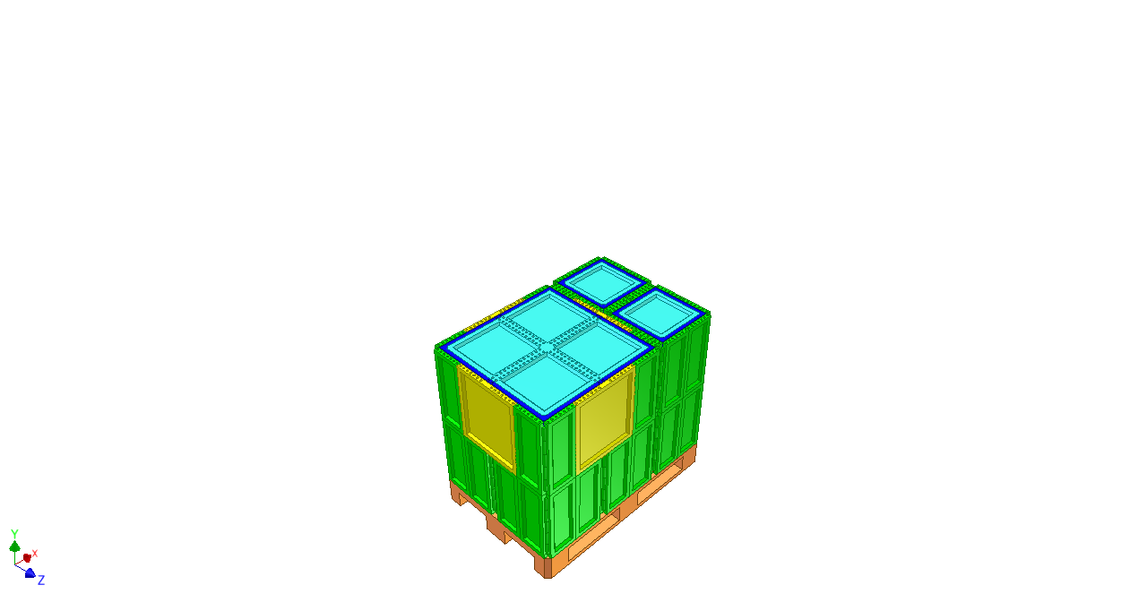
Consolidating various Box sizes on a Europallet...

Slide 23
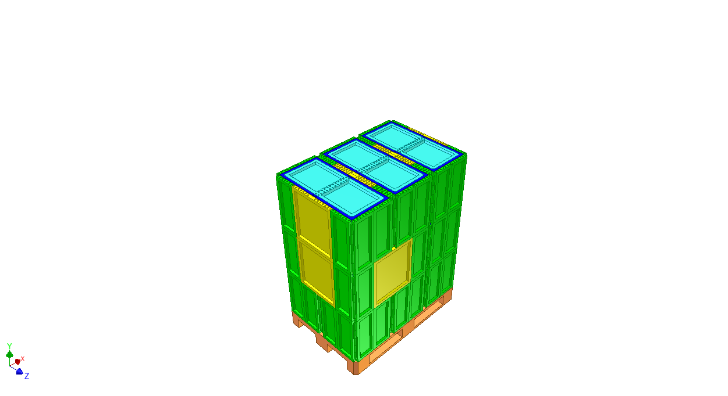
Consolidating various Box sizes on a Europallet...

Slide 24
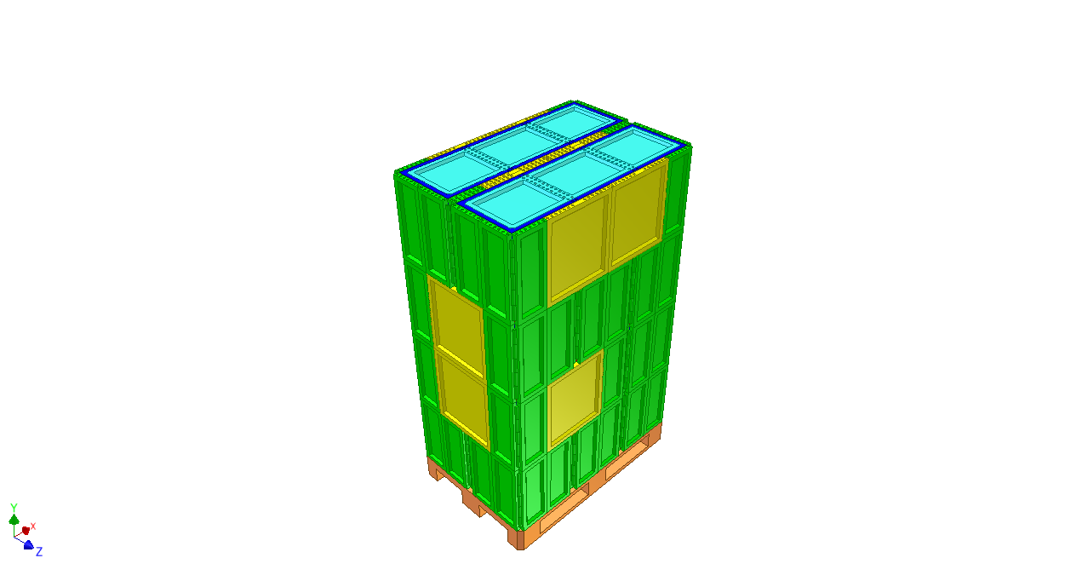
Consolidating various Box sizes on a Europallet...

Slide 25
Consolidating various Box sizes on a Europallet...

Slide 26
Many thanks for your attention!

