Slide 1
Swap Container
An innovative demountable body concept for vehicles with mechanical suspension...

Slide 2
Introduction
Over the decades, swap bodies have demonstrated a potential to increase driver, vehicle, and warehouse efficiency, productivity, and flexibility.
Nevertheless, swap bodies are nonexistent in developing countries due to technical challenges that impede their widespread use.
In Europe, swap bodies are designed for use with trucks equipped with full pneumatic suspension, which essentially allows for level control.
For trucks with full or partial mechanical suspension, hydraulic/pneumatic lifting subframes are employed to permit level control.

Slide 3
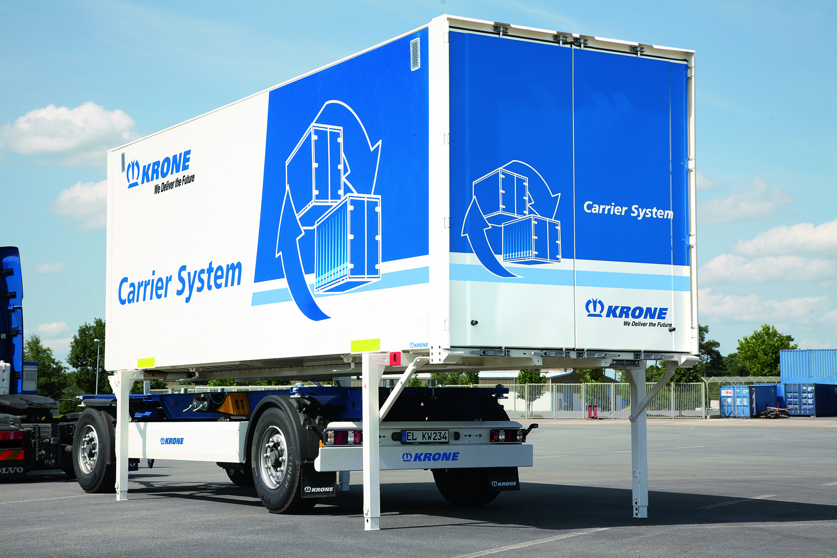
EU Swap Body

Slide 4
Background
Due to tough operational requirements, trucks in the developing world are predominantly sold with mechanical suspension.
Ordering, or even retrofitting, trucks for pneumatic suspension is not seen as a possible and/or viable option at present or in the near future.
Special lifting subframes are available, but the high cost and complexity of these systems typically renders them an unviable option.
An inexpensive, simplified, and robust solution for lifting and supporting a swap body is thus envisioned with the Swap Container concept.

Slide 5
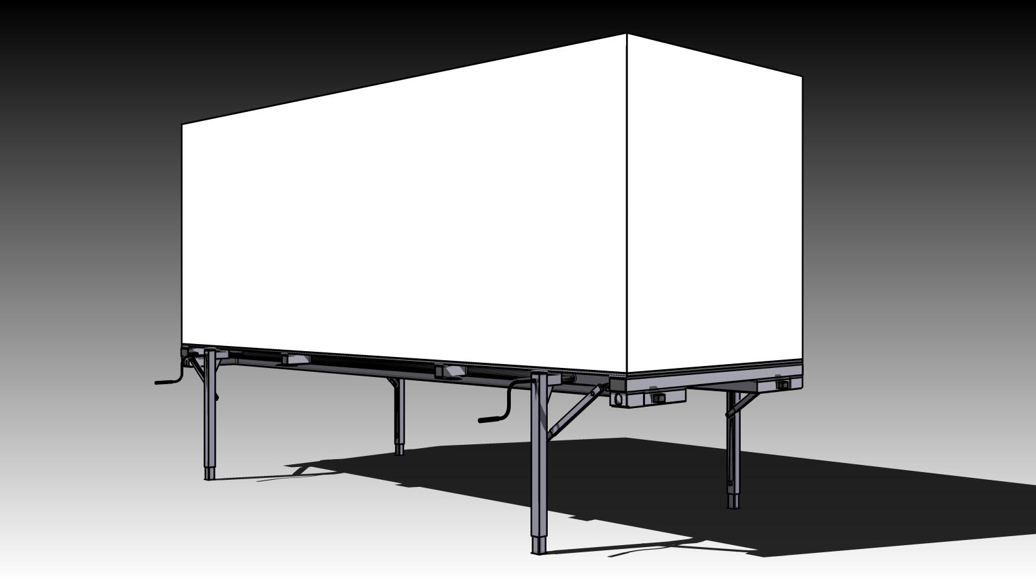
The Swap Container

Slide 6
The Swap Container
Although based on the design of conventional European swap bodies, the Swap Container differs due to its support legs, which incorporate a special heavy-duty lifting function.
The support legs on the Swap Container are telescopic and are driven by a robust bevel gear and axial spindle mechanism, which is of a similar design to the systems found on semi-trailer landing legs.
By effectively integrating the lifting function, the Swap Container might be an innovation that may facilitate the success of demountable bodies in the developing world!

Slide 7
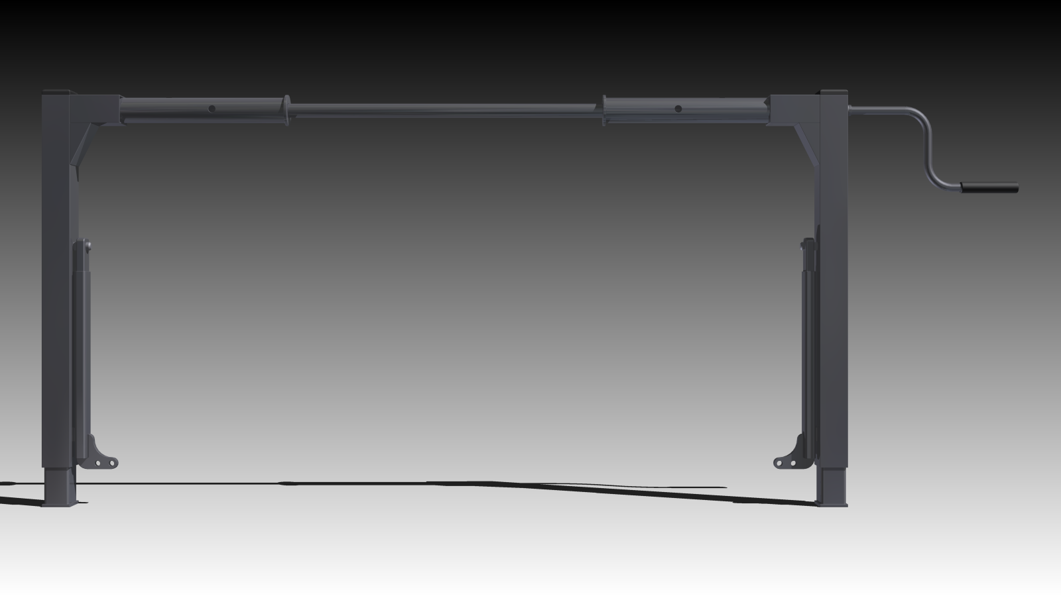
Telescopic Support Legs

Slide 8
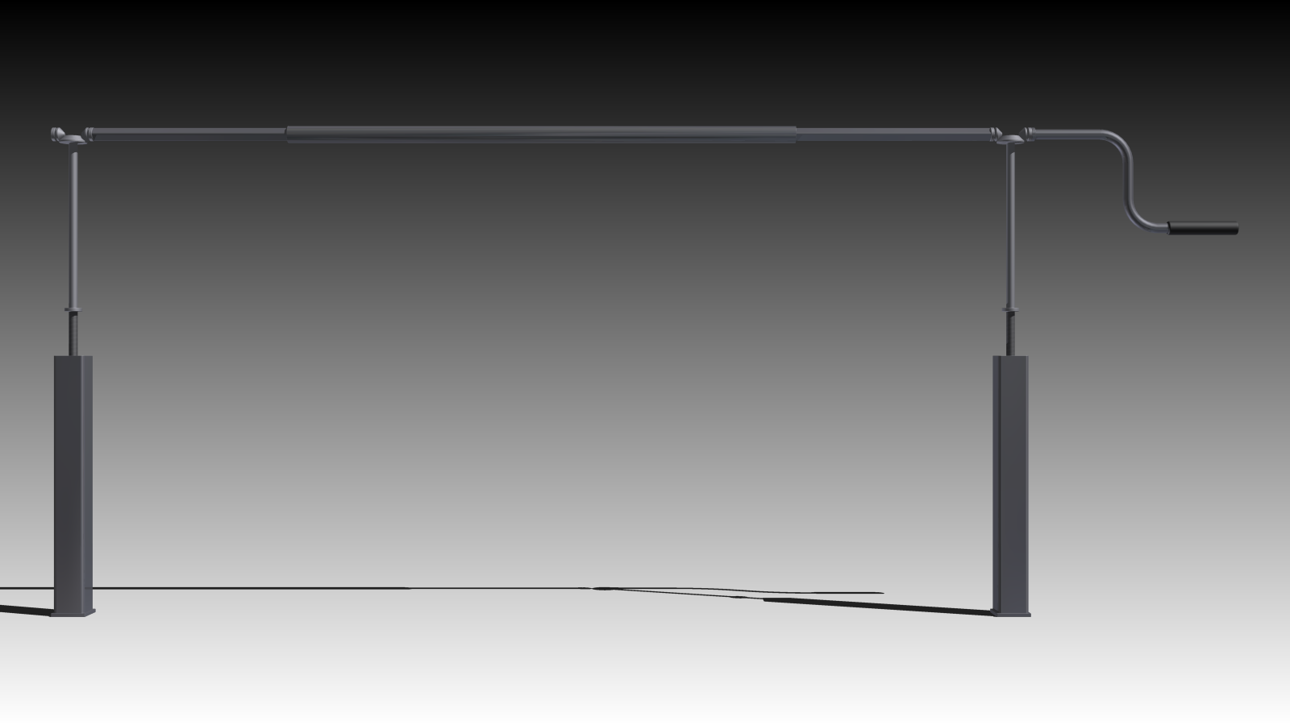
Integrated Lifting Mechanism
Bevel Gears (4x)
Connection Sleeve (1x)
Connection Shafts (2x)
Crank Handle (1x)
Axial Spindles (2x)
Telescopic Parts (2x)

Slide 9
In Operation...
The demounting procedure is almost as easy as it is with a European swap body. However, a two-man team is required (i.e. the driver and a yardman) to operate the two sets of support legs.
The truck parks at the loading yard and all twistlocks are unlocked...
The support legs are pulled out, rotated down, and fixed into position...
The crank handles are inserted into the left-hand side support legs...
The support legs are cranked until the body is 50mm above the chassis...
The twistlocks are retracted into their housings...
The truck slowly drives away...
The Swap Container stands freely at the loading yard...

Slide 10
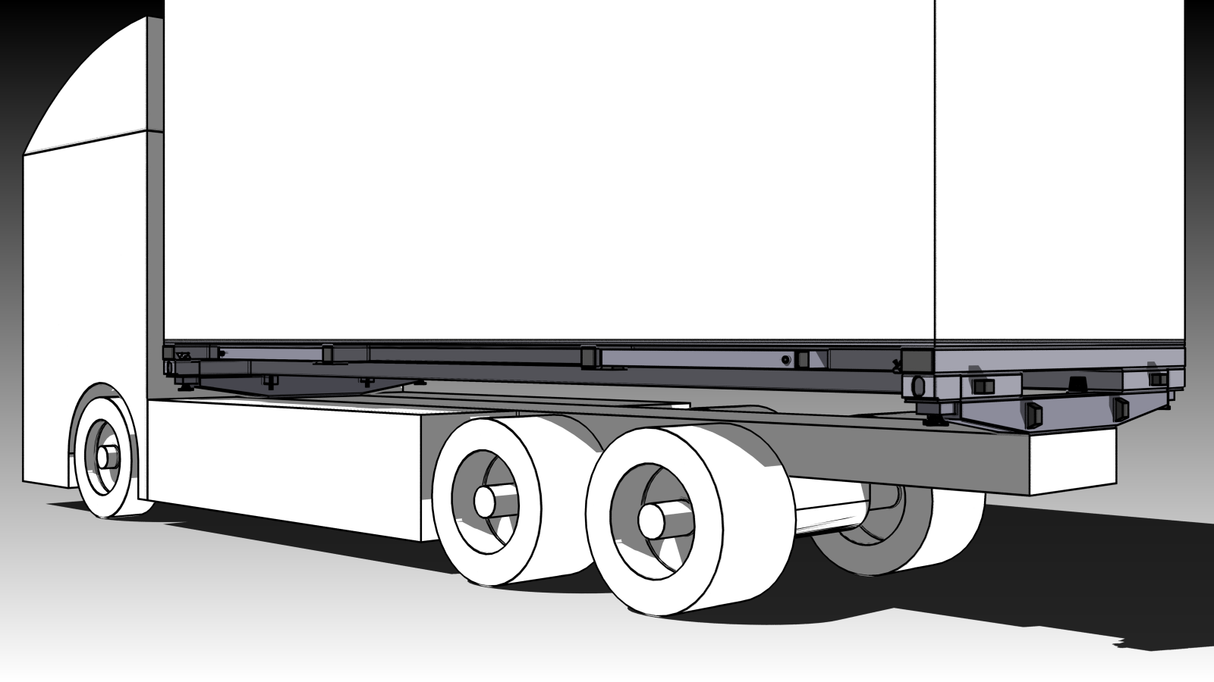
The truck parks at the loading yard and all twistlocks are unlocked...

Slide 11
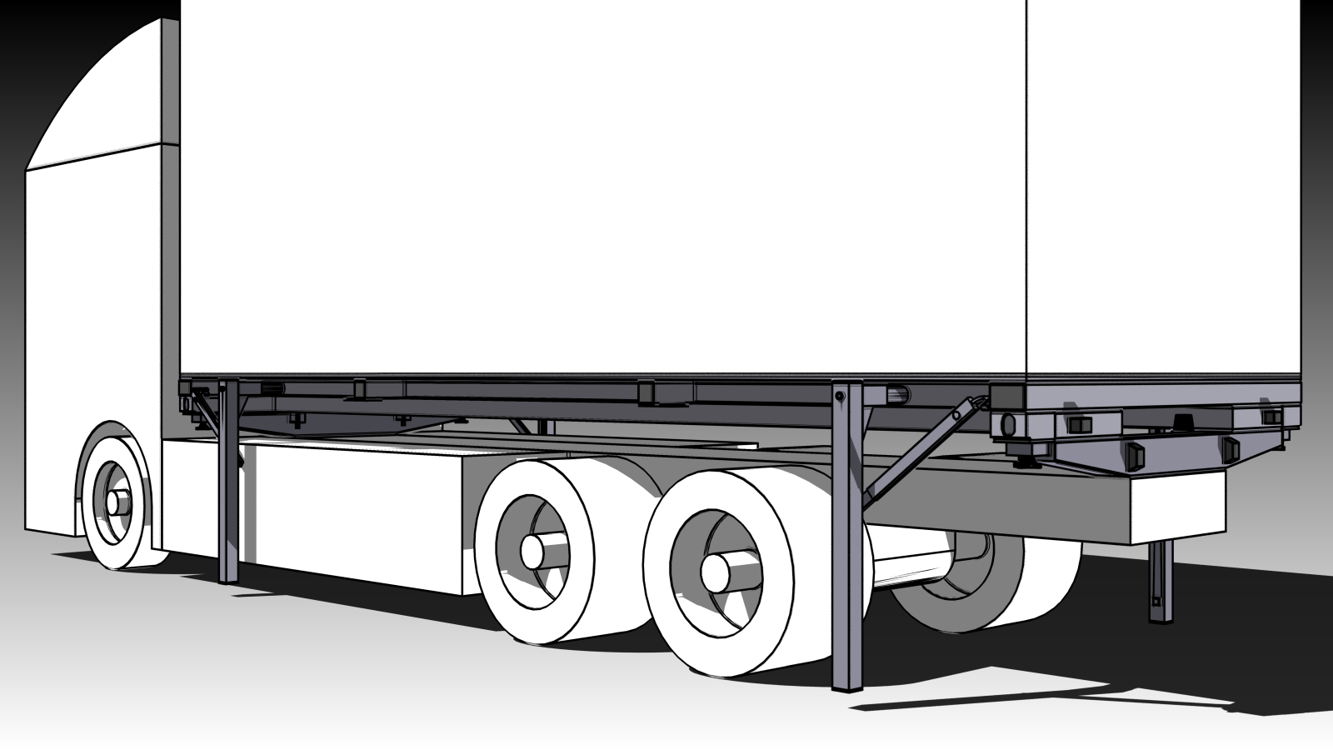
The support legs are pulled out, rotated down, and fixed into position...

Slide 12
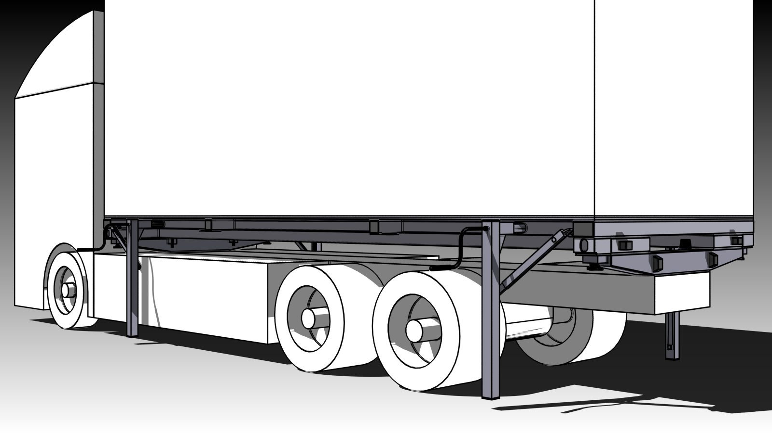
The crank handles are inserted into the left-hand side support legs...

Slide 13
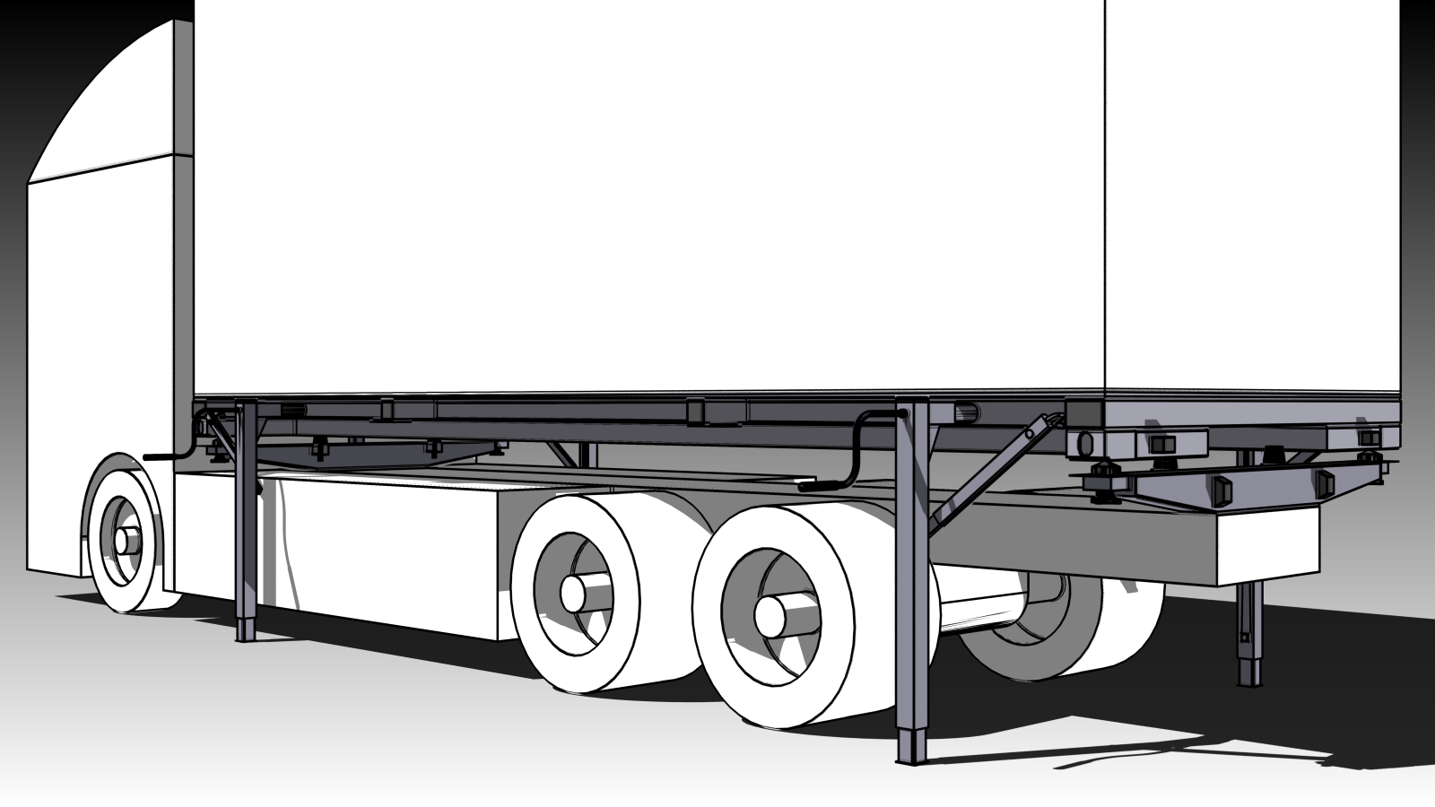
The support legs are cranked until the body is 50mm above the chassis...

Slide 14
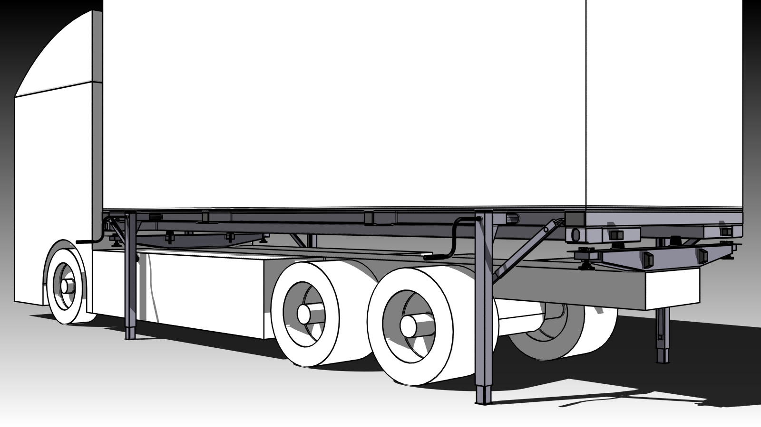
The twistlocks are retracted into their housings...

Slide 15
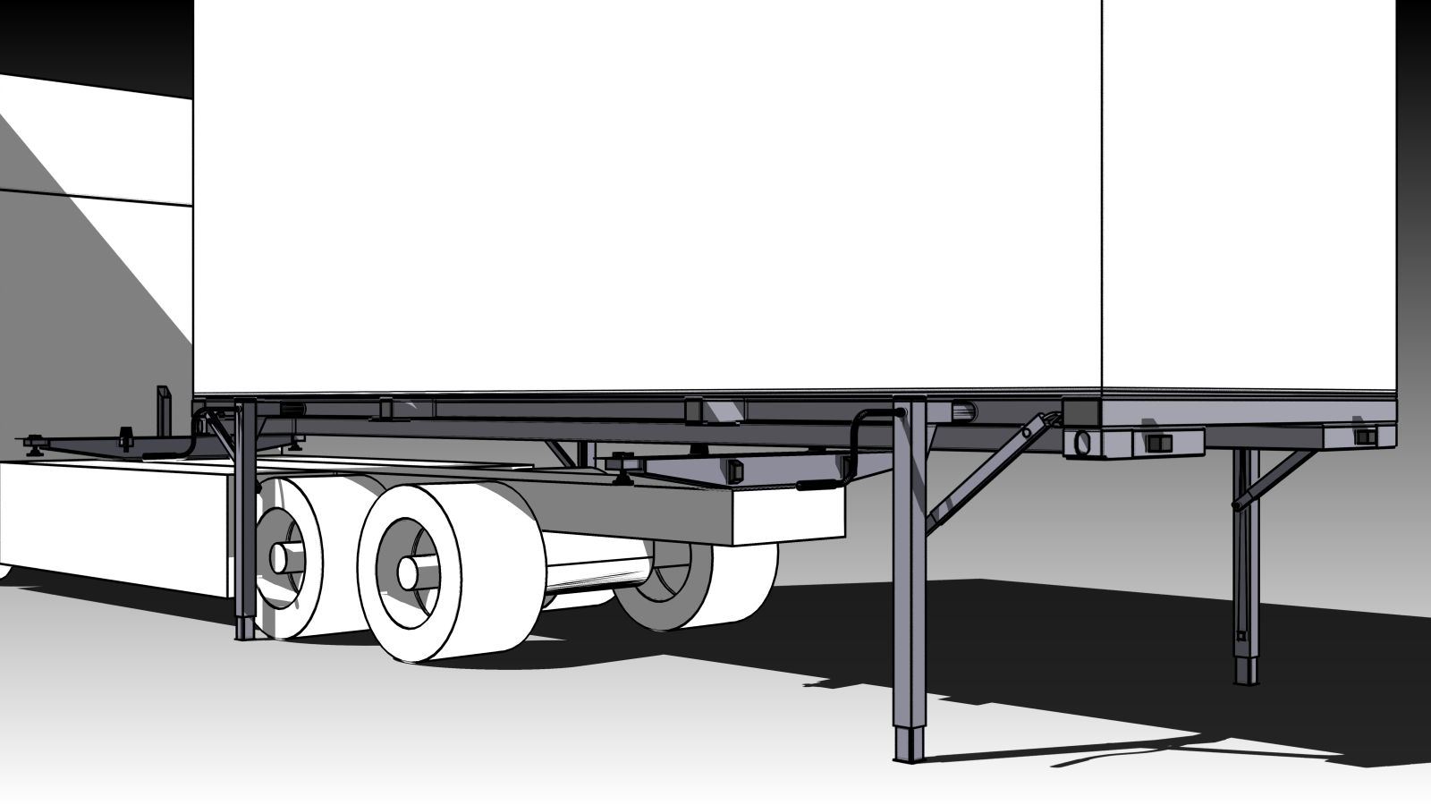
The truck slowly drives away...

Slide 16
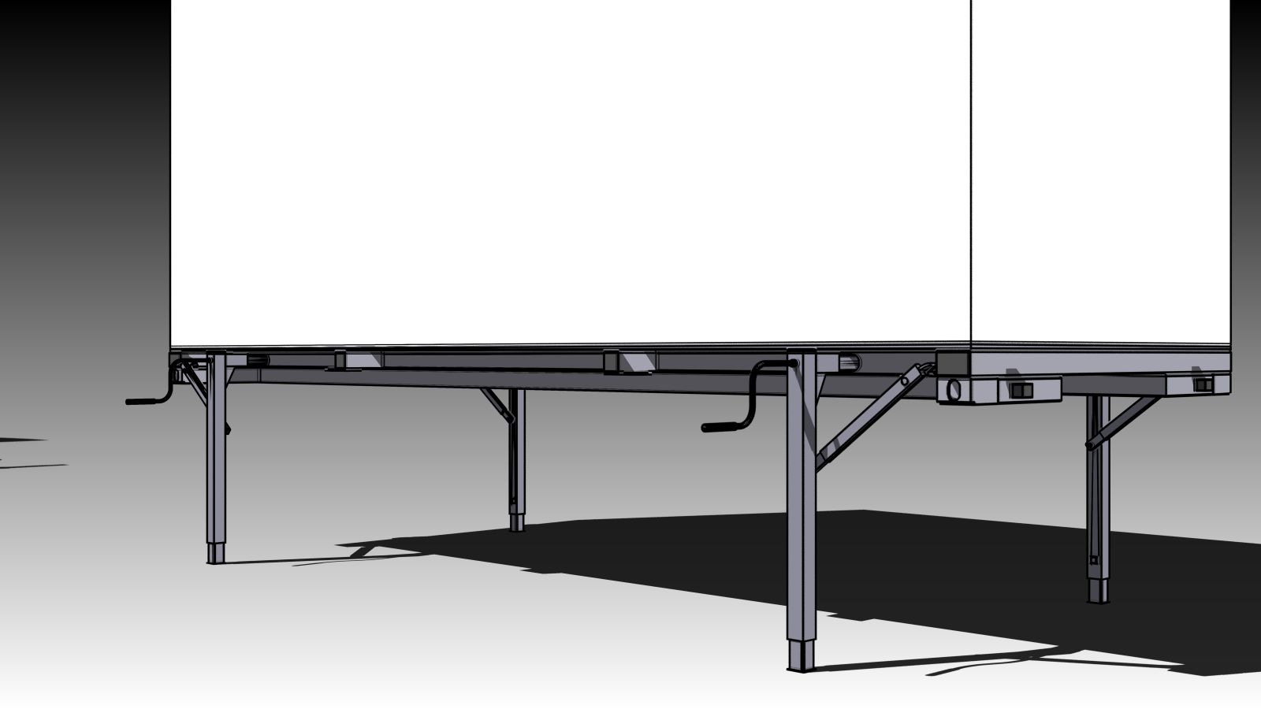
The Swap Container stands freely at the loading yard...

Slide 17
Moving Forward...
Initially, the Swap Container is produced and delivered in a basic form that includes functional and structural elements of the base module – the final bodywork, which is customer-defined, is fabricated locally by existing body builders at the export destination.
It is anticipated that the telescopic support legs would be manufactured in Europe while the steel framework would be manufactured in China. In this way, both high-quality and low costs are possible.
Up to eight (8) base modules could be shipped in a single 40’ HC container from a plant in China to any developing market across the globe...

Slide 18
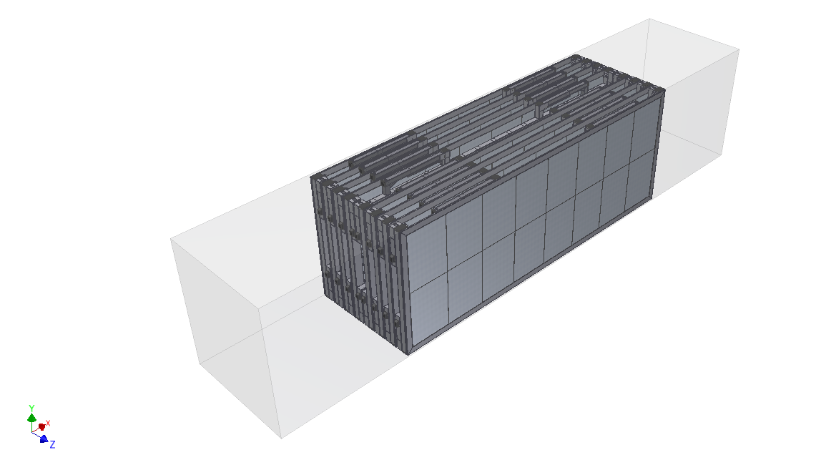
The Base Module (Shipped)

Slide 19
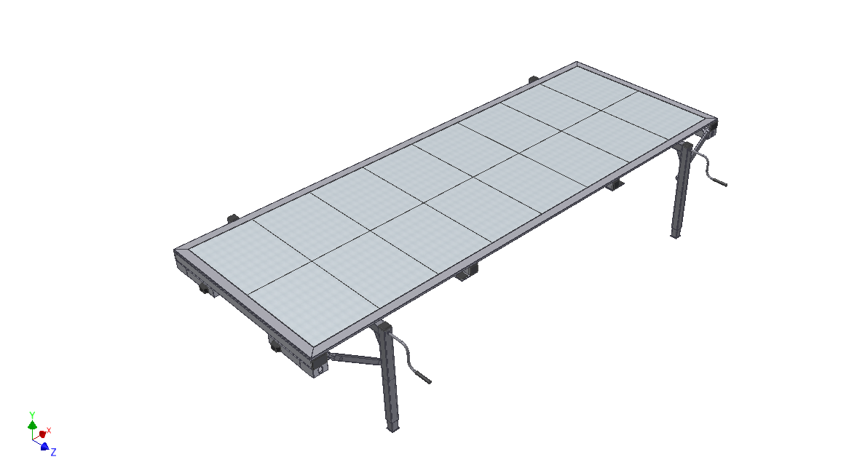
The Base Module (Delivered)

Slide 20
Thank You!
Any thoughts/comments/questions?

